Slide 1
Muhammad Fahad (FA19-BSSE-0014)
CPU SCHEDULING?
OPERATING SYSTEM

Slide 2
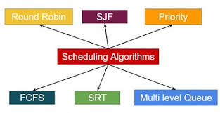
WHAT IS CPU SCHEDULING?
Way of Selecting a process from ready queue and putting it into the CPU
Ready queue in RAM is in which processes are ready to be executed

Slide 3

Pre-Emptive
A process from ready queue is put into the CPU to be executed.
And can be put back to the ready queue to be executed later.
Reasons can be time slice, priority, shortest process first etc.
Non Pre-Emptive
A process from ready queue is put into the CPU to be executed
Process will completely be executed taking its actual burst time

Slide 4
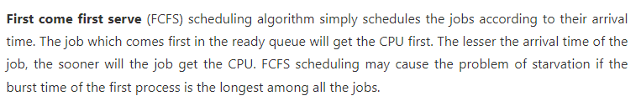
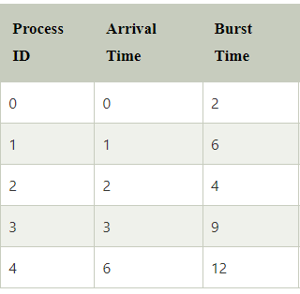

FIRST COME FIRST SERVE [non pre-emptive]

Slide 5
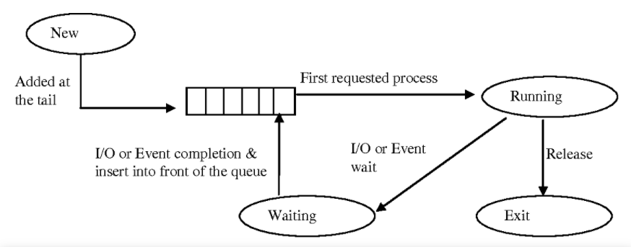
Continued

Slide 6
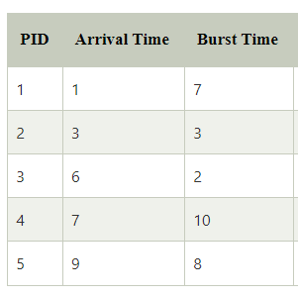
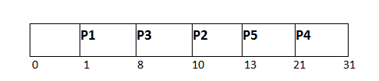
SHORTEST Job First [non pre-emptive]

Slide 7
Continued

Slide 8
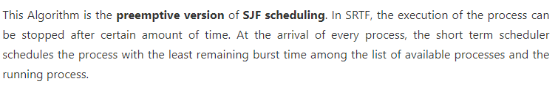
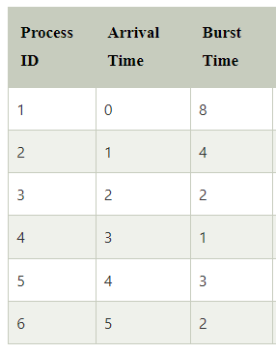
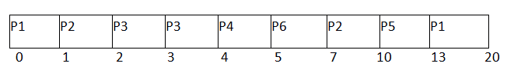
SHORTEST REMAINING TIME FIRST [pre-emptive]

Slide 9
Continued

Slide 10

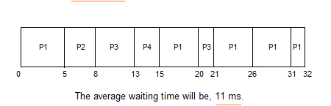
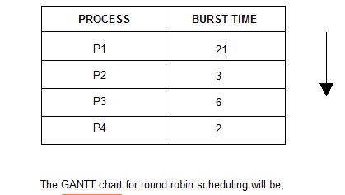
ROUND robin [pre-emptive]

Slide 11
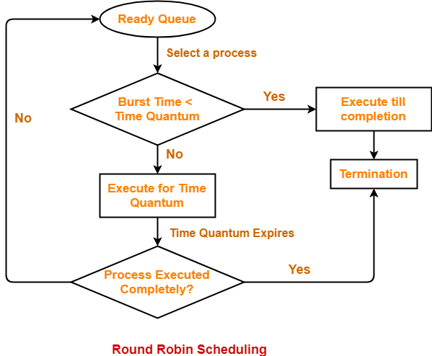
Continued

Slide 12
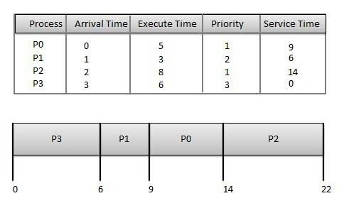
PRIORITY Scheduling

Slide 13
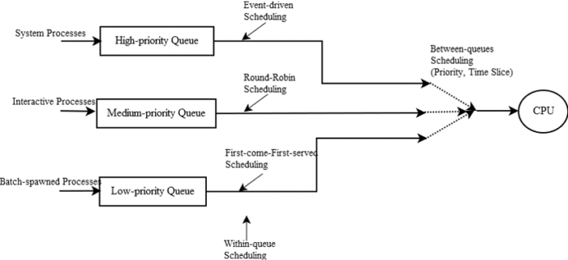
Multi Level Scheduling

Slide 14
Thank You!
Muhammad Fahad (FA19-BSSE-0014)

